Slide 1

Department Management System
Collaborative Internal Job Portal
Arpit arora 1610991167
Arshpreet singh sidhu 1610991183
Ashu singla 1610991199
Ashwani mittal 1610991200

Slide 2
Problem Statement
Collaborative Internal Job Portal
There are lot of man-hours being wasted in departments for the following tasks:
Selecting and deputing faculty for placement duties and any other duties of such sort.
Arranging alternate venues for placement and special tests.
Looking for a free lecture hall or a lab for any departmental purpose for e.g. Meetings.
All the above mentioned tasks are done manually by searching in the timetable (pdf format) of faculty and classrooms.

Slide 3
Objectives of the Project
Collaborative Internal Job Portal
Develop an application/web portal which automatically does the following:
Selects faculty required for placement duty without any bias.
Lists alternate venues and free lecture halls.

Slide 4
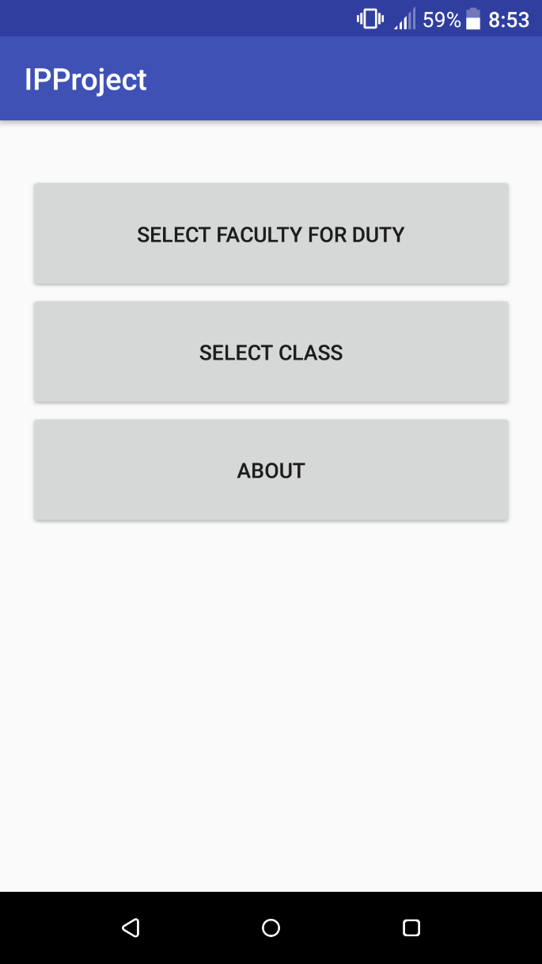
Android and Android Studio
Collaborative Internal Job Portal
We built a Android Application to Solve this Problem
Android Studio was used as IDE

Slide 5
Steps in Making this Application
Collaborative Internal Job Portal
Step 1 Understand Problem
Selecting faculty for placement duty
Step 2 Develop in Android Studio
Use Java and XML to build an app
Step 3 Testing on a Device
Run the app on a Real Android Phone
Use data of Facultywise and Classroomwise timetable
Debug and Improve the app overall
Find Free lecture hall

Slide 6
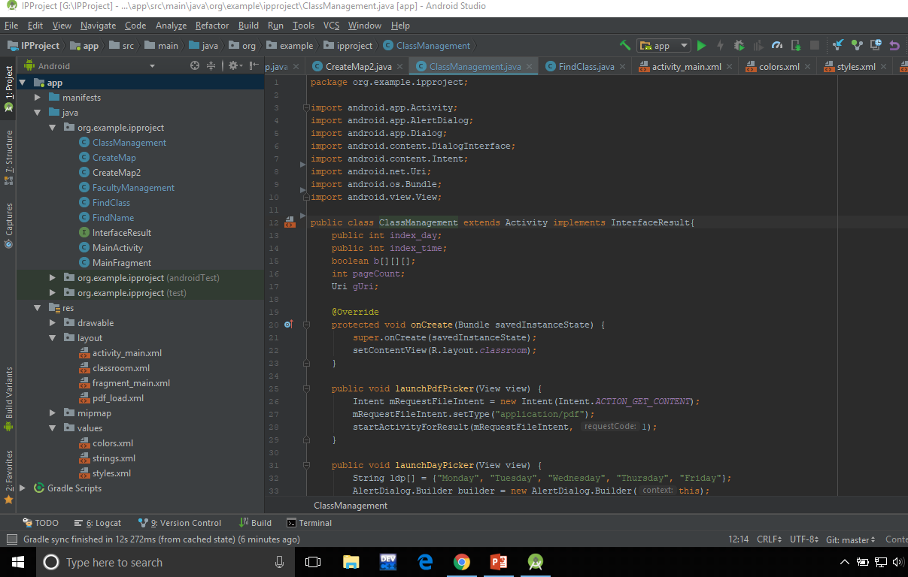
Development in Android Studio
Collaborative Internal Job Portal
Use xml for drawing the layout
Use of Java to code the application with help of android api.

Slide 7
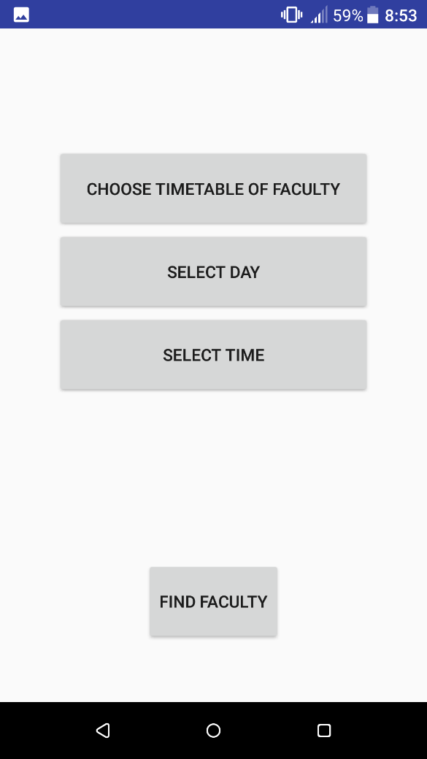
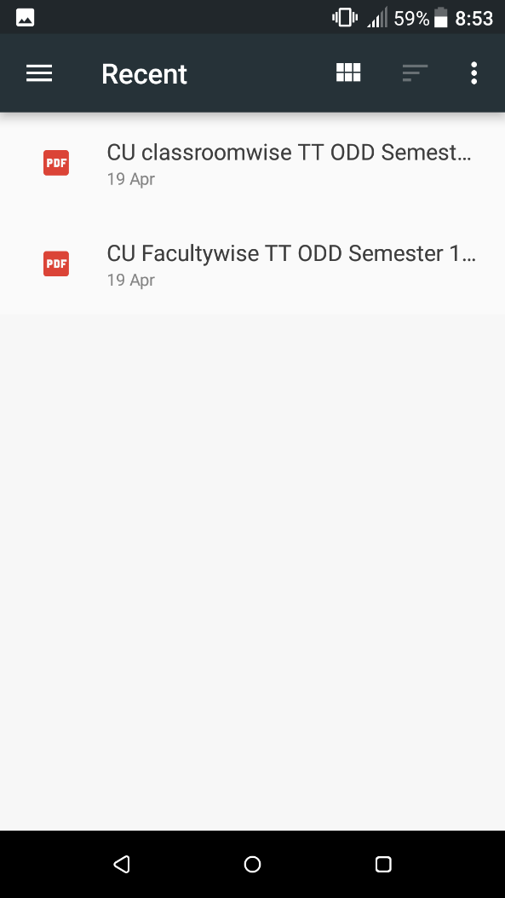
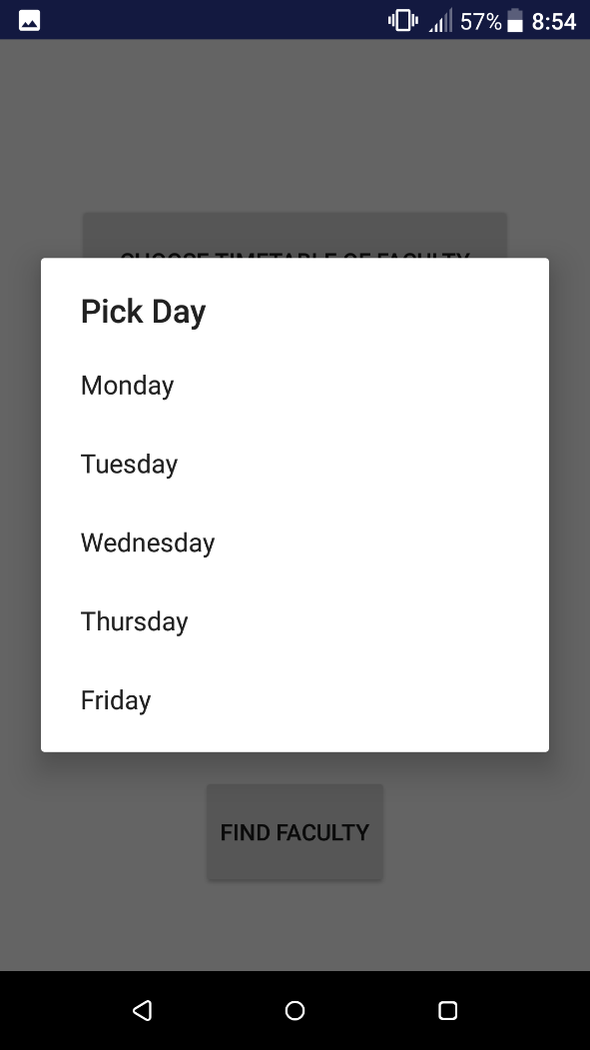
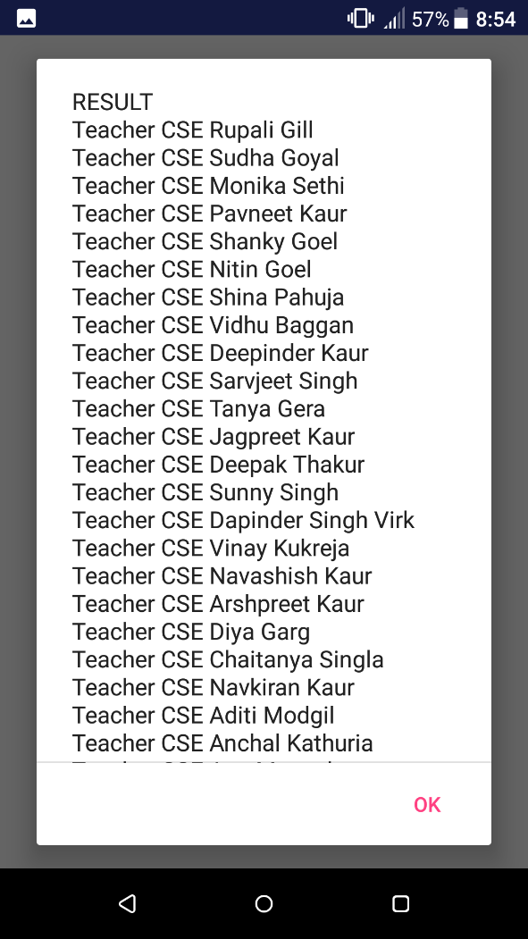
How to use the App
Collaborative Internal Job Portal
Select required pdf
Select timetable
Select day & time
Result

Slide 8
Collaborative Internal Job Portal
FUTURE SCOPE
We can make it more efficient by highlighting teachers which have less number of working hours.
We can use this app in our own University.
Easy and handy to be used in every college.

Slide 9
THANK YOU !
Collaborative Internal Job Portal

